Slide 1
Drinks

Slide 2
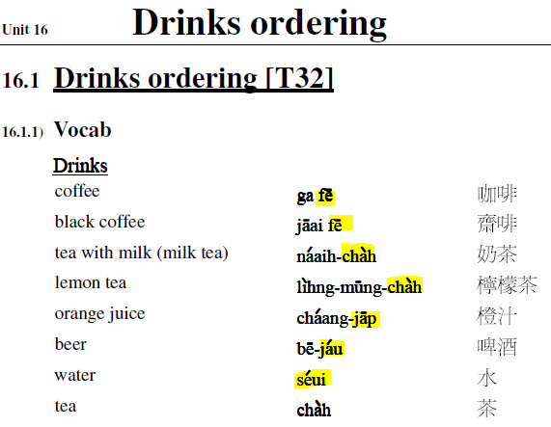
Sum up and elaborate
tea coffee juice liqueur water | caa4 fe1 zap1 zau2 Jit6 seoi2 | 茶 啡 汁 酒 水
Red tea coffee Apple juice Red wine Hot water Cold water | hung1caa4 fe1 pan4 go2 zap1 hung1 zau2 Jit6 seoi2 Dung1 seoi2 | 紅茶 啡 = brown X汁 紅酒 熱水 凍水

Slide 3
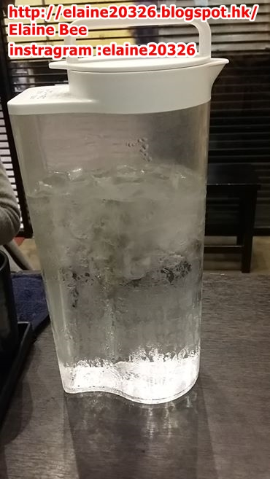
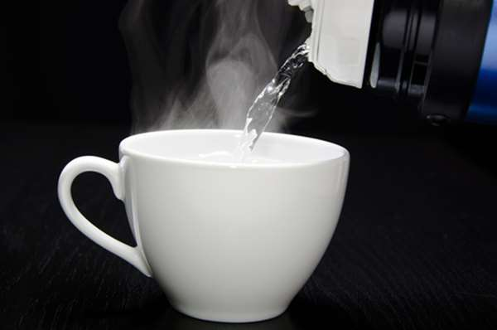

Slide 4
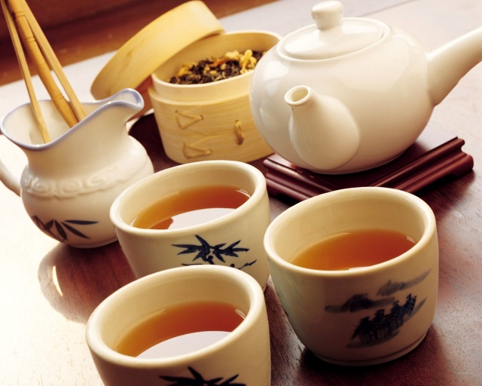
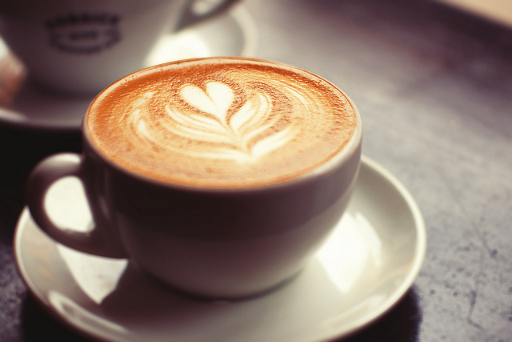
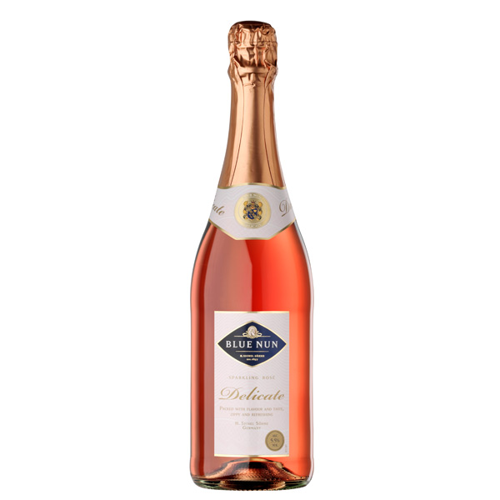
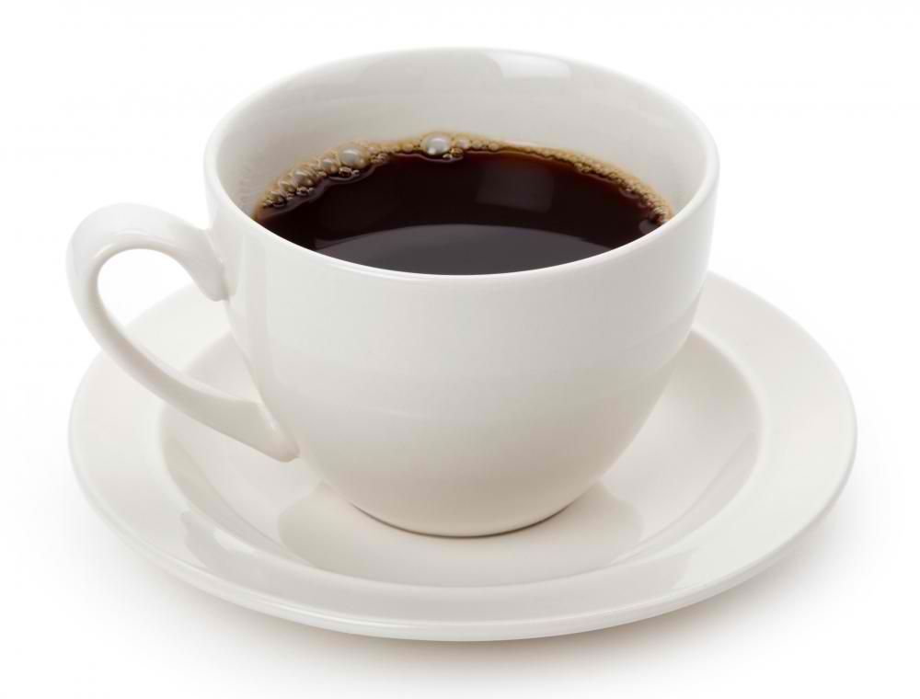
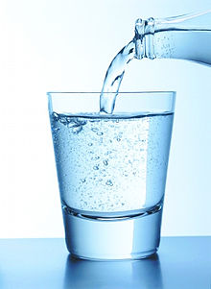

Slide 5
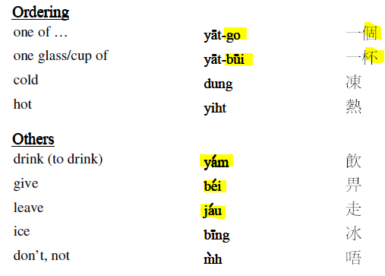
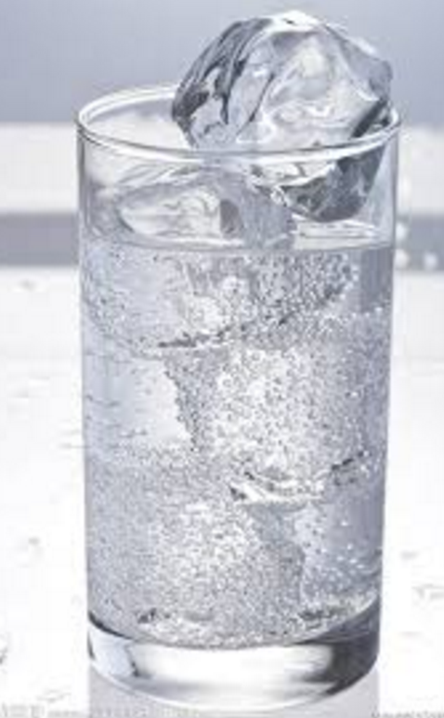
Measure word
Bui (for the container with a cup shape)
e.g. One cup of ice cream
Give me one cup of tea | bei2 jat1 bui1 caa4 ngo5 aa1 | 畀一杯茶我呀

